Slide 1


Bhanu Pratap Singh
August 19 2022

Slide 2

Outline
Executive Summary
Introduction
Methodology
Results
Conclusion
Appendix

Slide 3
Executive Summary
Summary of methodologies
Data Collection through SpaceX API
Data Collection using Web Scrapping
Exploratory Data Analysis
Exploratory Data Analysis with SQL
Exploratory Data Analysis by Data Visualization
Interactive Dashboard Visualization with Folium
Classification with Machine Learning
Summary of all results
Results of Exploratory Data Analysis
Results of Data Visualizations
Results of Machine Learning Analysis

Slide 4
Introduction
Project background and context
SpaceX advertises Falcon 9 rocket launches on its website, with a cost of 62 million dollars; other providers cost upward of 165 million dollars each, much of the savings is because SpaceX can reuse the first stage. Therefore if we can determine if the first stage will land, we can determine the cost of a launch. This information can be used if an alternate company wants to bid against SpaceX for a rocket launch.
Problems we want to find answers to.
What all factors can determine the successful landing ?
Combination of features that can determine the successful landing.
Which launching site is most successful from visualization analysis?
Which classification model is best for this problem?

Slide 5

Section 1

Slide 6
Methodology
Executive Summary
Data collection methodology:
Data was collected using SpaceX API and from Wikipedia page by using Web scrapping.
Perform data wrangling
Data was filtered for Falcon-9 launches. Null values were handled and one-hot coding was applied to categorical values.
Perform exploratory data analysis (EDA) using visualization and SQL
Perform interactive visual analytics using Folium and Plotly Dash
Perform predictive analysis using classification models
How to build, tune, evaluate classification models.

Slide 7
Data Collection
We employed 2 main methods to collect data :
We used SpaceX API.
We request and parsed the launch data using GET request.
We transfer the data into Pandas Dataframe using .json_normalize().
We filtered the data to include only Falcon 9 launches.
We replaced the missing values of Payload Mass with mean.
We used Web Scrapping on Wikipedia page of SpaceX’s launch data.
We used BeautifulSoup to web scrap.
Extracted the column names from HTML header.
Created a Pandas Dataframe by parsing the HTML table for launch details,

Slide 8
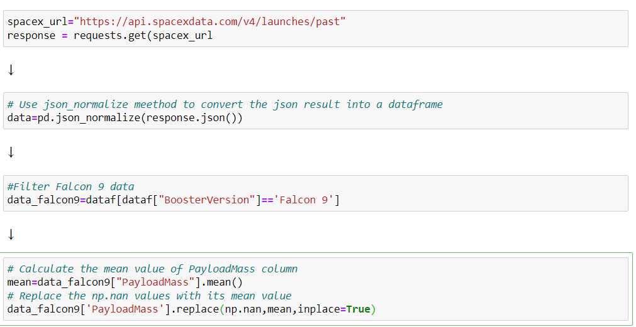
Data Collection – SpaceX API
We sent a get request to the SpaceX API, converted it into a Pandas dataframe. Filtered the data for Falcon9 launches and handled the missing values.
GitHub URL of the SpaceX API calls notebook: Data Collection API Notebook Link

Slide 9
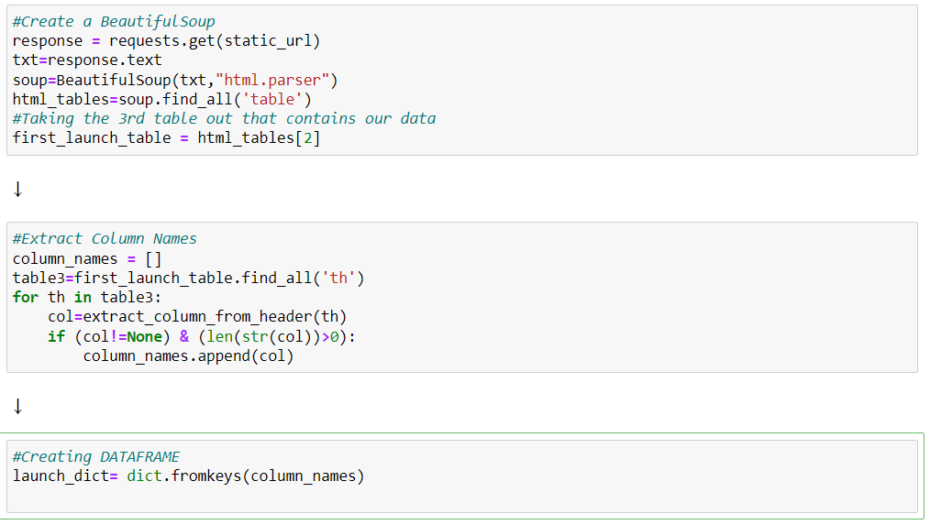
Data Collection – Web Scraping
We used BeautifulSoup to web scrap, extracted the column names and converted the data into a Pandas Dataframe.
GitHub URL of the web scraping notebook: Data Collection Web Scraping Notebook Link

Slide 10
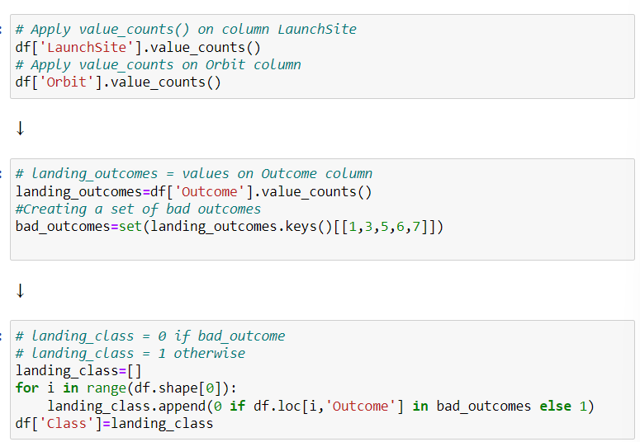
Data Wrangling
We first used value_counts() on LaunchSite, Orbit and Outcomes to see the occurrences of each.
Created a bad outcome set to separate bad outcomes from the successful ones.
We use it to give class label to Class to show the outcome.
We provide Class value =0 for bad outcomes.
We provide Class value =1 for successful outcomes.
GitHub URL : Data Wrangling Notebook Link

Slide 11
EDA with Data Visualization
We plotted Scatter Plots for the following :
Flight Number v/s Launch Sites
Payload v/s Launch Sites
Flight Number v/s Orbits
Payload v/s Orbits
We used scatter plots to see the relation between these two features for each.
We plotted Bar Chart for Orbits to show the success rate of each.
We plotted Line Chart to see how average success ratio changed with years.
GitHub URL : EDA Visualization Notebook Link

Slide 12
EDA with SQL
We performed EDA with SQL queries to get insights from data. The queries were:
Display names of each unique launch site
Display the total payload mass carried by boosters launched by NASA (CRS)
Display average payload mass carried by booster version F9 v1.1
Display the earliest date for successful landing outcome in ground pad
Display total number of successful and failed outcomes
Display failed outcome in drone ship with booster version, launch site in 2015.
GitHub URL : EDA SQL Notebook Link

Slide 13
Build an Interactive Map with Folium
We marked all launch sites and added map markers to mark the success and failure of each launch from the different sites.
We assigned class label 0 and 1 for failure and success outcome respectively.
Calculated distances between the launch sites and its proximities like coastline, highway and city.
To see if launch sites keep away from cities?
To see if they are close to coastlines?
How are they connected with highways and railways?
GitHub URL : Interactive Folium Notebook Link

Slide 14
Build a Dashboard with Plotly Dash
We built an interactive dashboard with Plotly Dash.
A dropdown menu with options to either select all or specific launch sites
A pie chart showing total successful launches for all sites or to show a pie chart between successful and failure ratio from specific sites.
We added a payload range slider to select a range of payload mass.
We plotted a scatter plot between outcome and payload mass picked from slider.
GitHub URL: Plotly Dash App Python Code Link

Slide 15
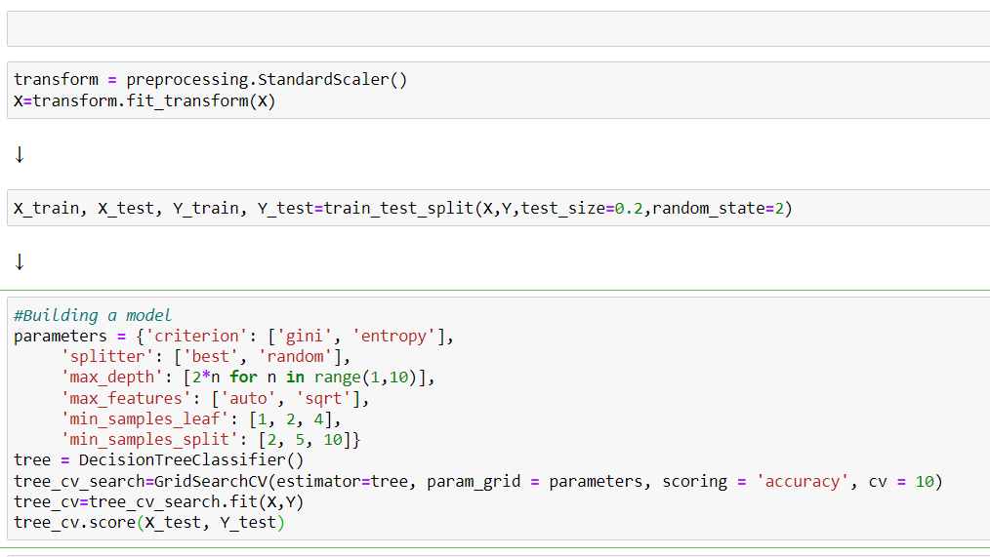
Predictive Analysis (Classification)
We loaded the data using numpy and pandas. Transformed the data using StandardScaler().
We split the data into train and test data with test size 0.2
We built different ML models and found best hyperparameters using GrisdSearchCV.
We found the best performing model.
GitHub URL : Machine Learning Analysis Notebook Link

Slide 16
Results
Exploratory data analysis results
•Space X uses 4 different launch sites;
•The first launches were done to Space X itself and NASA;
•The average payload of F9 v1.1 booster is 2,928 kg;
•The first success landing outcome happened in 2015 fiver year after the first launch;
•Many Falcon 9 booster versions were successful at landing in drone ships having payload above the average;
•Almost 100% of mission outcomes were successful;
•Two booster versions failed at landing in drone ships in 2015: F9 v1.1 B1012 and F9 v1.1 B1015;
•The number of landing outcomes became as better as years passed.
Predictive analysis results
Predictive analysis showed that Decision Tree Classifier is the best classification model for our data with accuracy of 90%.
Only 1 case each of False Positive and False Negative.

Slide 17
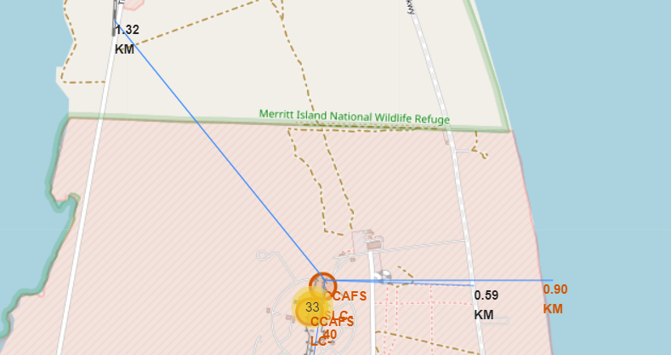
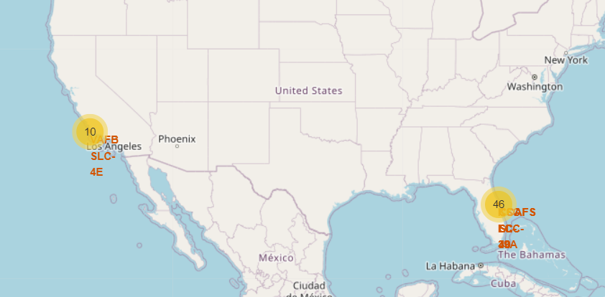
Results
Interactive analytics demo in screenshots
Using interactive analytics was possible to identify that launch sites use to be in safety places, near sea, for example and have a good logistic infrastructure around.
Most launches happen at east coast line.

Slide 18

Section 2

Slide 19
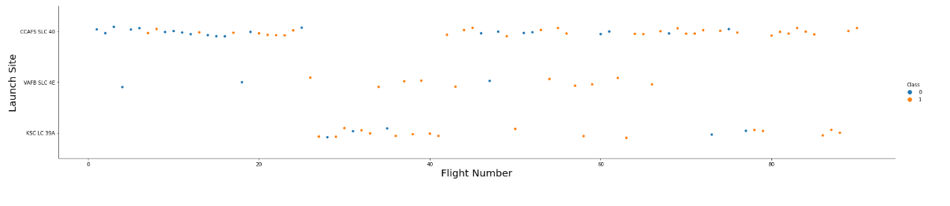
Flight Number vs. Launch Site
We see how with increase in Flight numbers, we see more data plots with class label 1.
This indicates that with increase in flight number the chances of a successful outcome is high for each launch site.

Slide 20
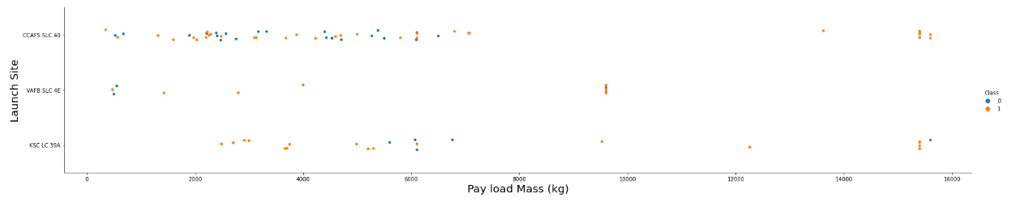
Payload vs. Launch Site
We see that with high payload mass we have more points with data label 1.
This shows that launches with high payload mass have more chances for successful outcome than a low payload mass launch.

Slide 21
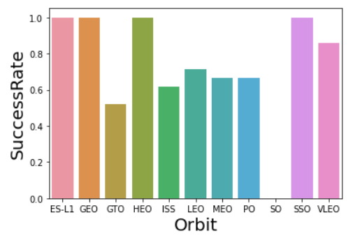
Success Rate vs. Orbit Type
We see that launches for orbit ES-L1, GEO, HEO and SSO have perfect success rate of 1.
The orbit GTO has less success rate with value of about 0.5.
The orbit SO has not had a successful launch and has a 0 score.

Slide 22
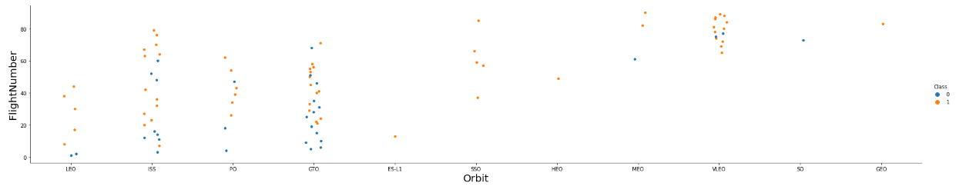
Flight Number vs. Orbit Type
We see that in the LEO orbit the Success appears related to the number of flights.
On the other hand, there seems to be no relationship between flight number when in GTO orbit

Slide 23
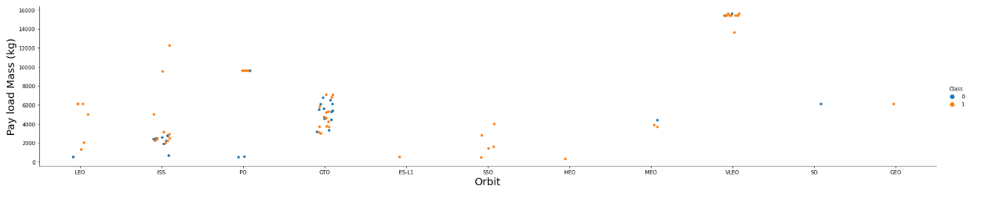
Payload vs. Orbit Type
With heavy payloads the successful landing or positive landing rate are more for Polar, LEO and ISS.
However for GTO we cannot distinguish this very well as both of the positive landing rate and negative landing(unsuccessful mission) are there.

Slide 24
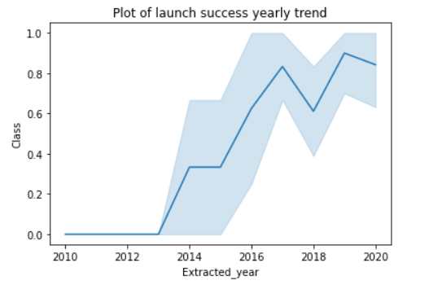
Launch Success Yearly Trend
We see that success rate has been on a rise since year 2013.
However, there was a downfall for success rate in the year 2018.

Slide 25
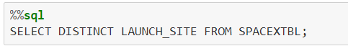
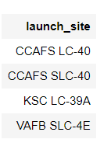
All Launch Site Names
We select DISTINCT launch sites from the table.
We get these 4 outcomes as unique Launch Sites.

Slide 26
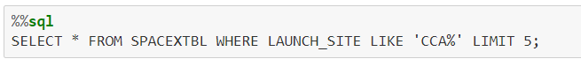
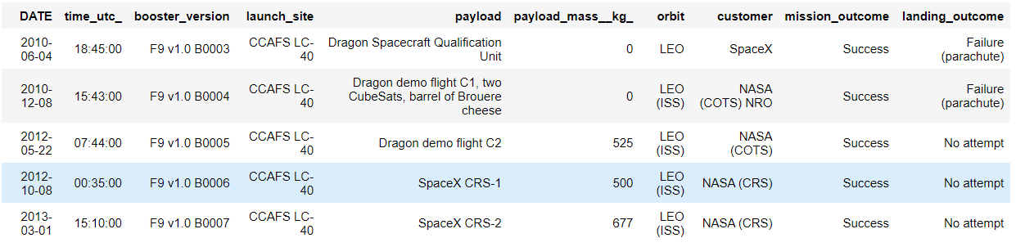
Launch Site Names Begin with 'CCA'
We display first 5 record where the Launch Sites begin with CAA using LIKE operation.

Slide 27
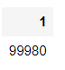
Total Payload Mass
We calculate the total payload mass (kg) carried by boosters launched by NASA and get the value of 99,980 KG.
We do so by using TOTAL operation in our query.

Slide 28
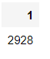
Average Payload Mass by F9 v1.1
We calculate the average payload mass (kg) carried by booster version F9 v1.1 and get the value of 2928 KG.
We do so by using AVG operation in our query.

Slide 29
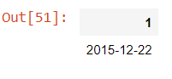
First Successful Ground Landing Date
We calculate the earliest date for a successful landing on a ground pad and get the date as 2015-12-22.
We do so by using MIN operation in our query.

Slide 30
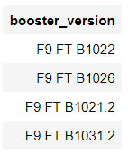
Successful Drone Ship Landing with Payload between 4000 and 6000
We list the booster versions which have a successful landing on a drone ship and the Payload is between 4000-6000 KG.
We do so by using AND in our query.
We could have also use BETWEEN in our query.

Slide 31
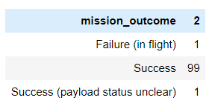
Total Number of Successful and Failure Mission Outcomes
We calculate total successful and failure mission outcomes and get 100 Successful mission and 1 Failure mission.
We do so by using GROUP BY operation in our query.

Slide 32
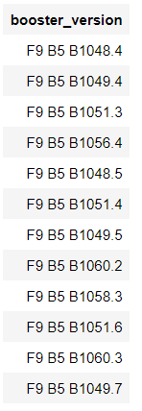
Boosters Carried Maximum Payload
We display the boosters that carried maximum payload weight and get these values.
We do so by using a SUB QUERY in our query and use MAX operation in that sub query.

Slide 33
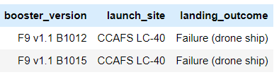
2015 Launch Records
We display booster version, launch site and the landing outcome for failed landing outcome in 2015. We get the result as shown.
We do so by using BETWEEN in our query.

Slide 34
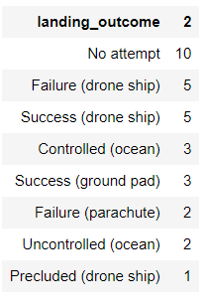
Rank Landing Outcomes Between 2010-06-04 and 2017-03-20
We landing outcome, and their occurrences between specified dates. We get this output as shown.
We do so by using COUNT BETWEEN ORDER BY & GROUP BY in our query.

Slide 35

Section 3

Slide 36
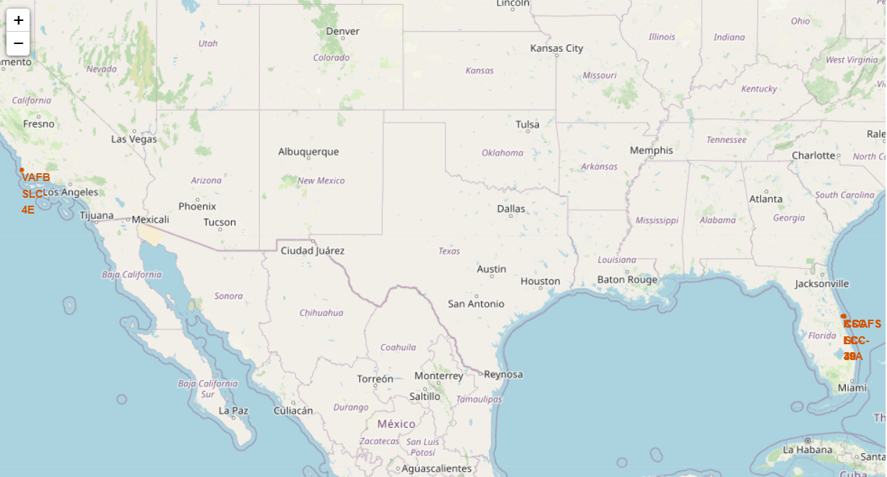
Launch Sites on Map of USA.
We see that the SpaceX’s Launch sites are in United States of America.
All launch sites are in coastal region.
California has 1 Launch Site. Florida has 3 Launch Sites.

Slide 37
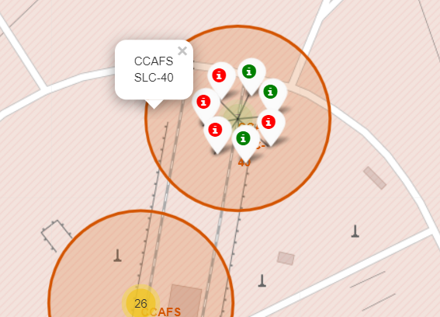
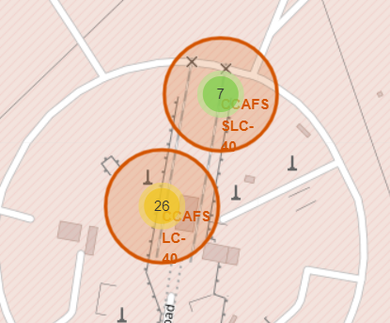
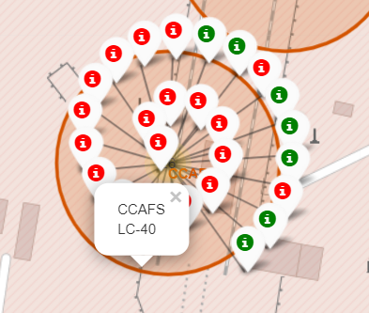
Launch Sites with Success & Fail Landing Markers
We show two sites CCAFS SLC-40 & CCAFS LC-40 both in Florida.
We see that CCAFS LC-40 has a low success ratio. While, CCAFS SLC-40 has a balanced success ratio.

Slide 38
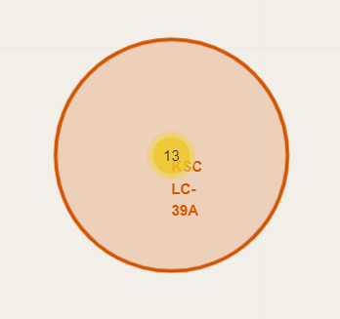
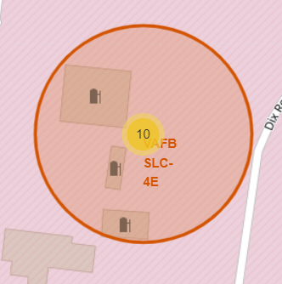
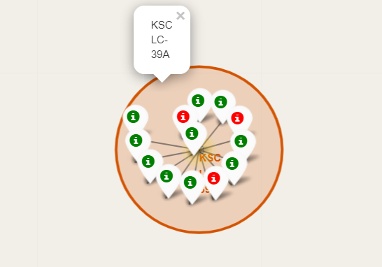
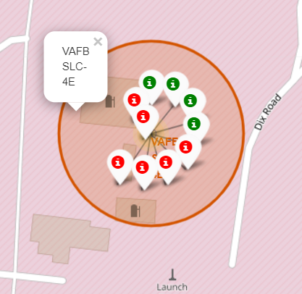
Launch Sites with Success & Fail Landing Markers
We have two sites:
KSC LC- 39A on left located in Florida.
VAFB SLC- 4E on right located in California.
We observe that KSC LC- 39A has a very high success ratio.
Relatively, VAFB SLC- 4E has an average success ratio.

Slide 39
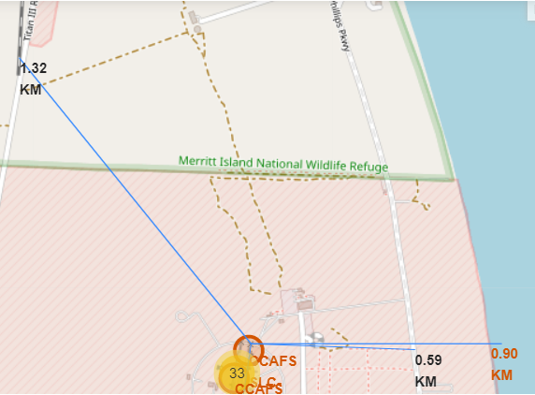
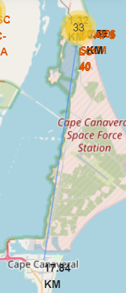
Logistics and Safety
We calculate distance of CCAFS SLC-40 from nearest :
Coastline-0.90KM
Railways- 1.32 KM
Roadways-0.59KM
City – 17.84 KM
We see that the launch site is conveniently connected to road, rail & coastline for easy transportation.
It also keeps a certain distance from City, hence it is also safe.
Railway-1.32km
City – 17.84Km
Coast - 0.90Km
Roadway - 0.59Km

Slide 40

Section 4

Slide 41
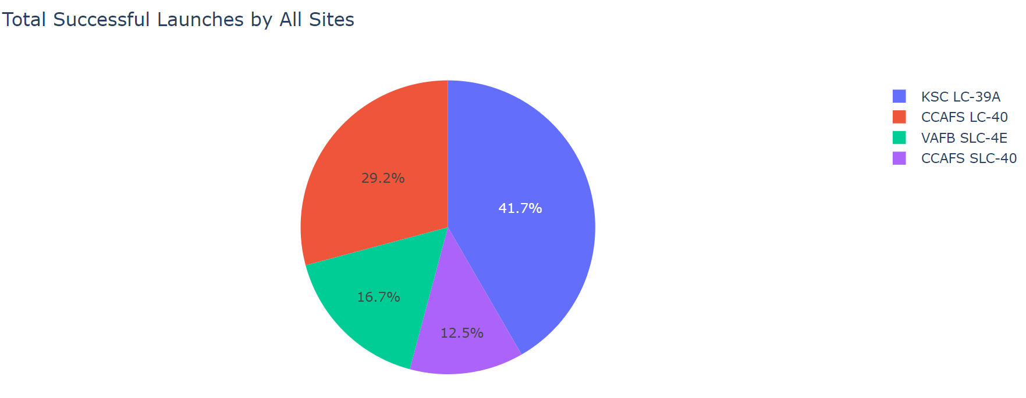
Pie Chart for Successful Launches for All Sites
We plot the pie chart and observe that KSC LC-39A has highest number of successful launches. We also observe that CCAFS SLC-40 has lowest number.

Slide 42
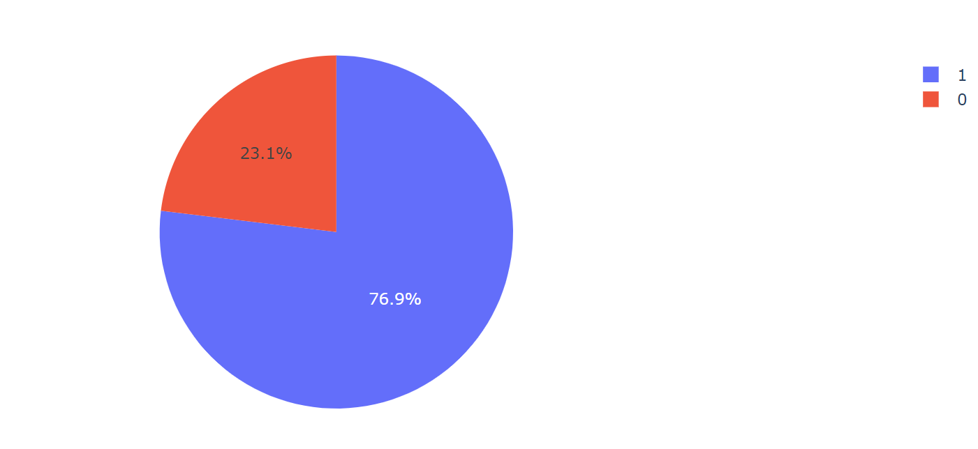
Pie Chart for Success ratio of KSC LC-39A
We plot the pie chart for KSC LC-39A and observe that it has a high success rate of 76.9%.

Slide 43
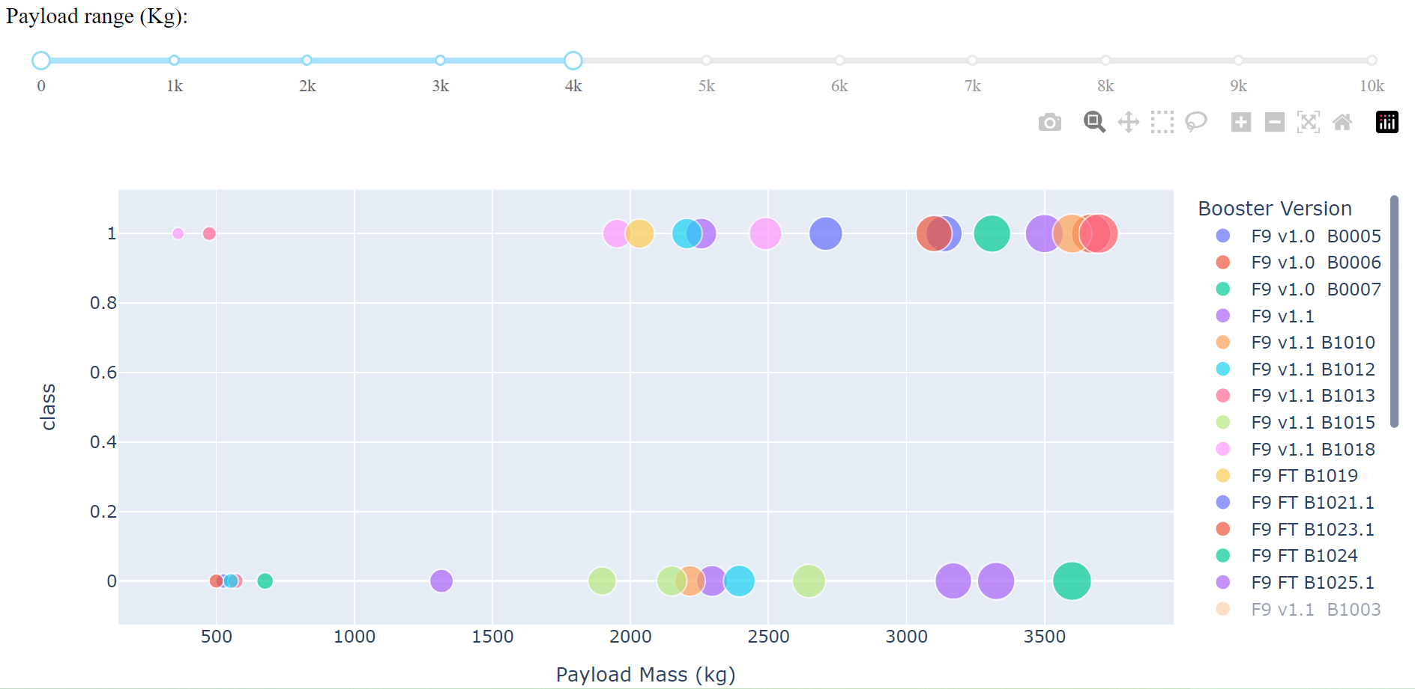
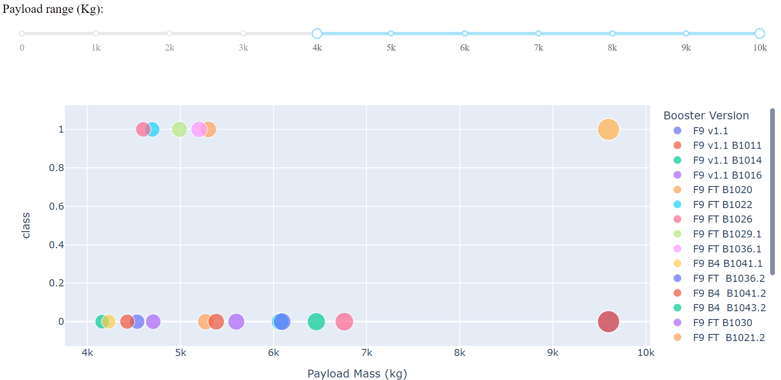
Scatter plot for all sites with different ranges in payload range slider plotting Payload vs. Outcome
We plot two scatter plots for payload ranges of 0-4000Kg & 4000-10,000Kg.
We observe that 0-4000Kg range has more points for class=1. Relatively, 4000-10,000Kg has less.
Thus, we can say that if we observe data from all sites, the launches with low payload mass have had more number of successes than those with high payload mass.

Slide 44

Section 5

Slide 45
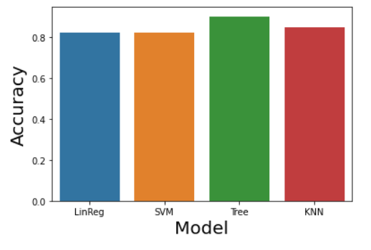
Classification Accuracy
We plot a bar chart for accuracy of our different classification models.
Linear Regression – 0.822
SVM – 0.822
Decision Tree – 0.90
KNN – 0.844
Hence, we see that Decision Tree is the best model for our classification purpose.

Slide 46
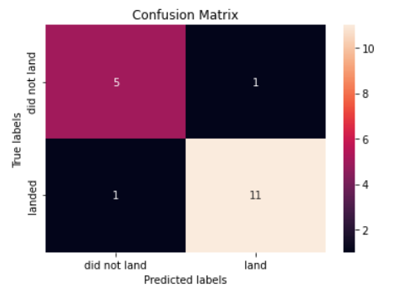
Confusion Matrix
We plot the Confusion Matrix for Decision Tree Classifier.
We observe that it has 1 case each of False-Positive and False-Negative.
This is a pretty good model for classification as it has 11 True-Positive and 5 True-Negative.

Slide 47
Conclusions
We conclude that all chances of success increase with increase in number of flights for all sites.
We conclude that Success rate is increasing with passing years.
We conclude that launch site KSC LC-39A has highest success rate and highest number of successful launches.
We conclude that the launch site has to be conveniently connected with railway, road and coastline. Also, it has to be a certain distance from residential area.
We conclude that Decision Tree Classifier is the best model for classification whether launch is successful or not.
We have answered all questions we set out to find answers to.

Slide 48
Appendix
The best tuned hyperparameters of our model are:
tuned hpyerparameters :(best parameters) {'criterion': 'gini', 'max_depth': 16, 'max_features': 'sqrt’, 'min_samples_leaf': 2, ‘min_samples_split': 10, 'splitter': 'best’}.
The GitHub notebook will not show the folium maps as it will not trust the notebook.
Some notebooks may have large content of json file, kindly scroll down for complete code.

Slide 49


